Slide 1


Human Fatalities and Destroyed Aircraft Due to Wildlife Strikes, 1912 to Present
Jeff Follett, Phil Shaw, Richard Dolbeer & Jeff McKee
World Birdstrike Association Conference
Warsaw, Poland
November 2018
Acknowledgement: John Thorpe & John Richardson
Notes:
WELCOME and INTRODUCTION
Introduction to Avisure

Slide 2

Overview
Civil and military wildlife strike history
New additions to the hull loss and fatality database
Pyramid indicators and risk management
Notes:
Overview: Broad Stats
Cost estimated from Allan 2002 and updated to 2016 dollars

Slide 3
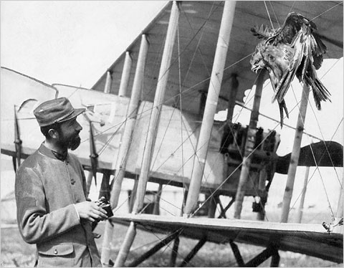
History
First recorded strike: 1905
First recorded fatal strike: 1912
Hull Losses: 614
Fatalities: 551
Estimated Cost Civil (2018) USD$2B/annum
USD $50,325/strike
Notes:
Allan estimated $1.2 BN in 2000 which translates to $1.76BN in 2018
We estimate based on airline data that the average strike costs USD$47418 in 2016 = USD$50325 in 2018 at an estimated 60000 strike worldwide/year = total of $3.02BN
So in 2018 mean of these two is $2.4BN/year, ~$2BN is a conservative estimate

Slide 4
Fatalities and Destroyed Aircraft - Worldwide
 | No. Hull Losses | No. Fatalities
Civil | 203 | 339
Military | 411 | 212
Total | 614 | 551
NOTES:
      1. Reporting diligence varies significantly, figures are probably grossly underestimated
Notes:
Overview: MIL vs CIV

Slide 5
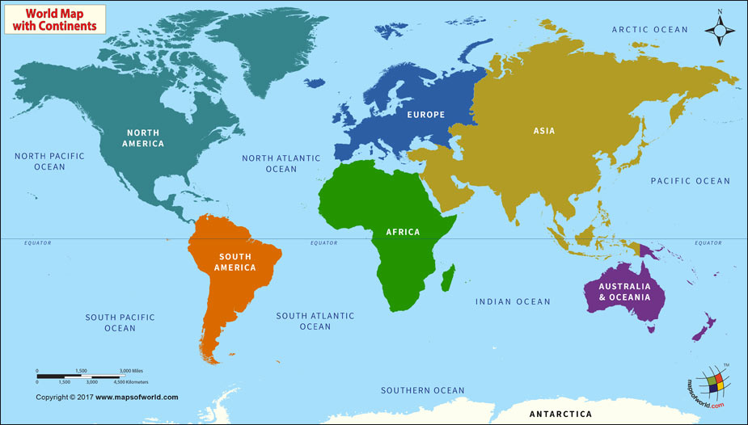
Wildlife Caused Accidents by Region (Civil & Military)
UK 76 HL/22 FAT
Canada 17 HL/11 FAT
Europe 182 HL/123 FAT
USA 195 HL/219 FAT
Asia 64 HL/63 FAT
Middle East 21 HL/10 FAT
Central America 16 HL/8 FAT
Africa 30 HL/85 FAT
South America 5 HL/3 FAT
Australia 8 HL/3 FAT
HL = Hull Losses
FAT = Fatalities
Notes:
Number of accidents related to the probability (# of birds in the area an the number of aircraft) but can see it is a worldwide issue

Slide 6
Hull Losses Per Decade
Notes:
Likely that implementation of wildlife management programs has assisted in reduced number of accidents
But it is a small sample so not unusual to see “swings” in the data

Slide 7
Fatalities Per Decade
Notes:
Civil green
Military Purple
Despite recent decreases, still an increasing trend from the beginning of manned flight (likely a factor of probability due to more aircraft)
Difficult to get data and often receive data after long periods of time, so likely an underestimate in numbers particularly with the military
Civil data easier to find than military
Speaking from our experiences in military and civil environments, easier to practice separation in military environment

Slide 8
Bird Species (where known) Involved in Hull Loss Accidents Worldwide
Notes:
% take into account the difference in total number of accidents:
Gulls 2x more likely for military
Old world vultures 1,5x as likely for military
New world vultures 2x as likely for military
Hawks 3x for military
Ducks 4x for military
Terrestrial, particularly deer, far more likely for civil

Slide 9
Bird Species (where known) Involved in Fatal Accidents Worldwide
Notes:
This is the % of accidents that had fatalities that involved these species
Ducks stand out
Interesting the difference in old versus new world vultures
Geese 1.5x more likely for military

Slide 10
Altitude (where known) of Accidents Worldwide
Notes:
Military time spent in the 500 to 3000 foot is greater compared to civil seen in the next two slides about phase of flight

Slide 11
Phase of Flight of Civil Accidents Worldwide
Notes:
Take-off, landing, approach, climb mains areas

Slide 12
Phase of Flight of Military Accidents Worldwide
Notes:
Enroute
Greater quantity of unknown due to difficult of obtaining data

Slide 13
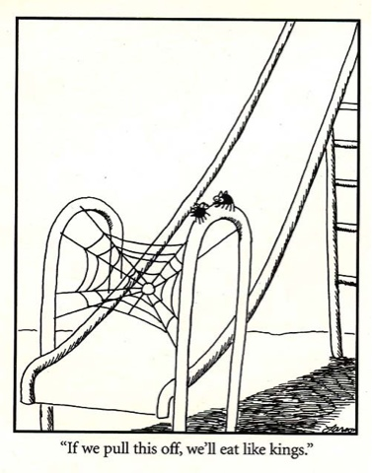
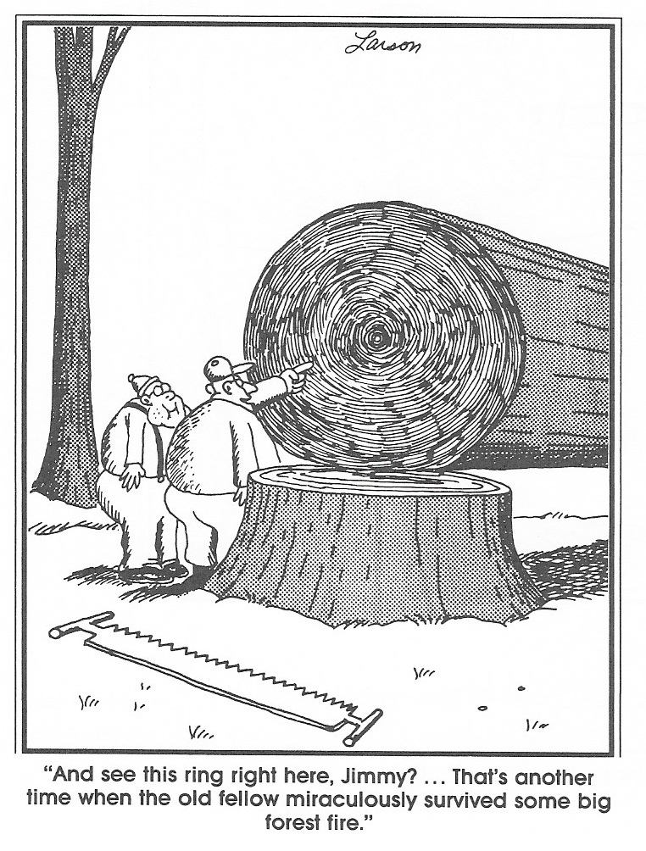

Wait for Something Big to Happen
Notes:
Transition from data to how we use this and what we do in the future
I want to use a couple recent additions to the database to discuss our current approach to analyzing wildlife strike data

Slide 14
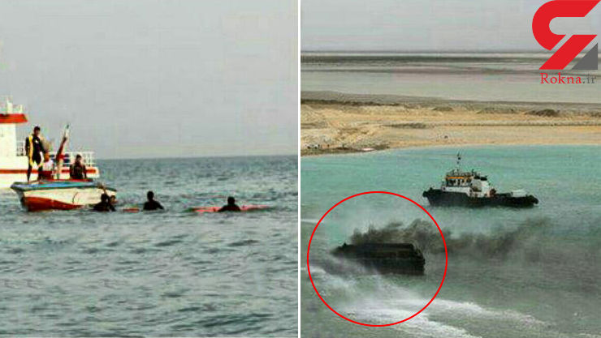
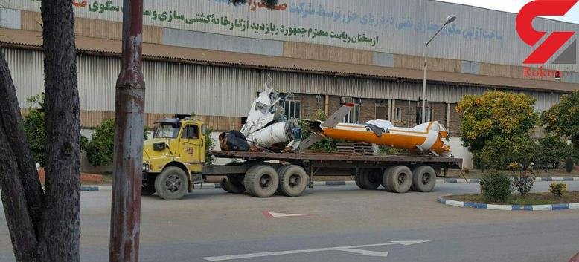
New Additions to the Database
Since the presentation in Baltimore August 2018
USA
  October 1958
  C123-D – flock of geese
  19 fatalities
Iran
  November 2016
  Mil Mi-171
  5 fatalities
Notes:
Two examples are 58 years apart and on surface are disparate:
Helicopter versus fixed wing
Military versus civil
Over water versus land
Different species (gull versus goose)
However, share important commonalities:
Bird strike remains a likely cause of these incidents
People lost their lives due to the accidents
Investigations concluded other reasons
plane was overloaded, and that the pilot may have been incapacitated, crew rest restrictions violated, or the pilot seat's was not occupied by qualified pilot
lack of observance of the rules of night flight by the pilots. Ultimately, they had been disorientated or lacking in situational awareness.
Not clear in either case that bird strike was initially considered to be (2 years later “recent research indicated that gulls were near helipad for

Slide 15
Investigating Accidents
A rancher said the plane appeared to be flying through a flock of the big birds. He said "the formations of geese broke up and the birds flew in all directions.”
Idaho Aeronautics Director said he did not think geese could have caused the crash.
Notes:
Many times it is determined that bird strike was not involved prior to the actual investigation
This means that biological considerations are not included
Which makes it impossible to use the process to prevent the next incident

Slide 16
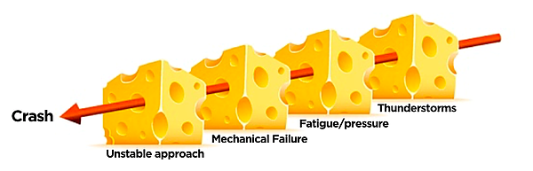
A reactive (but necessary)process
Investigating Accidents
MAJOR
ACCIDENT
Bird Collision/ingestion
INVESTIGATION ……… RUN!!!!
Notes:
The whole point of this reactive response is to develop proactive strategies to prevention - so we don’t have to react as much in the future.
Most accidents are multifactorial - Ideally we don’t want to be investigating major accidents – we want to prevent them. One way to effectively prevent them is to harness the information derived from frequent standardised investigation of “minor” incidents.
614 accidents are included in this data over 106 years
ICAO estimates that there were approximately 65,000 strikes 2011-14 (4 years). That’s 100x
If we were more detailed in investigating and acting upon minor strikes we may be able to prevent serious strikes. Of course, investigating that many strikes with current approaches would be onerous.

Slide 17
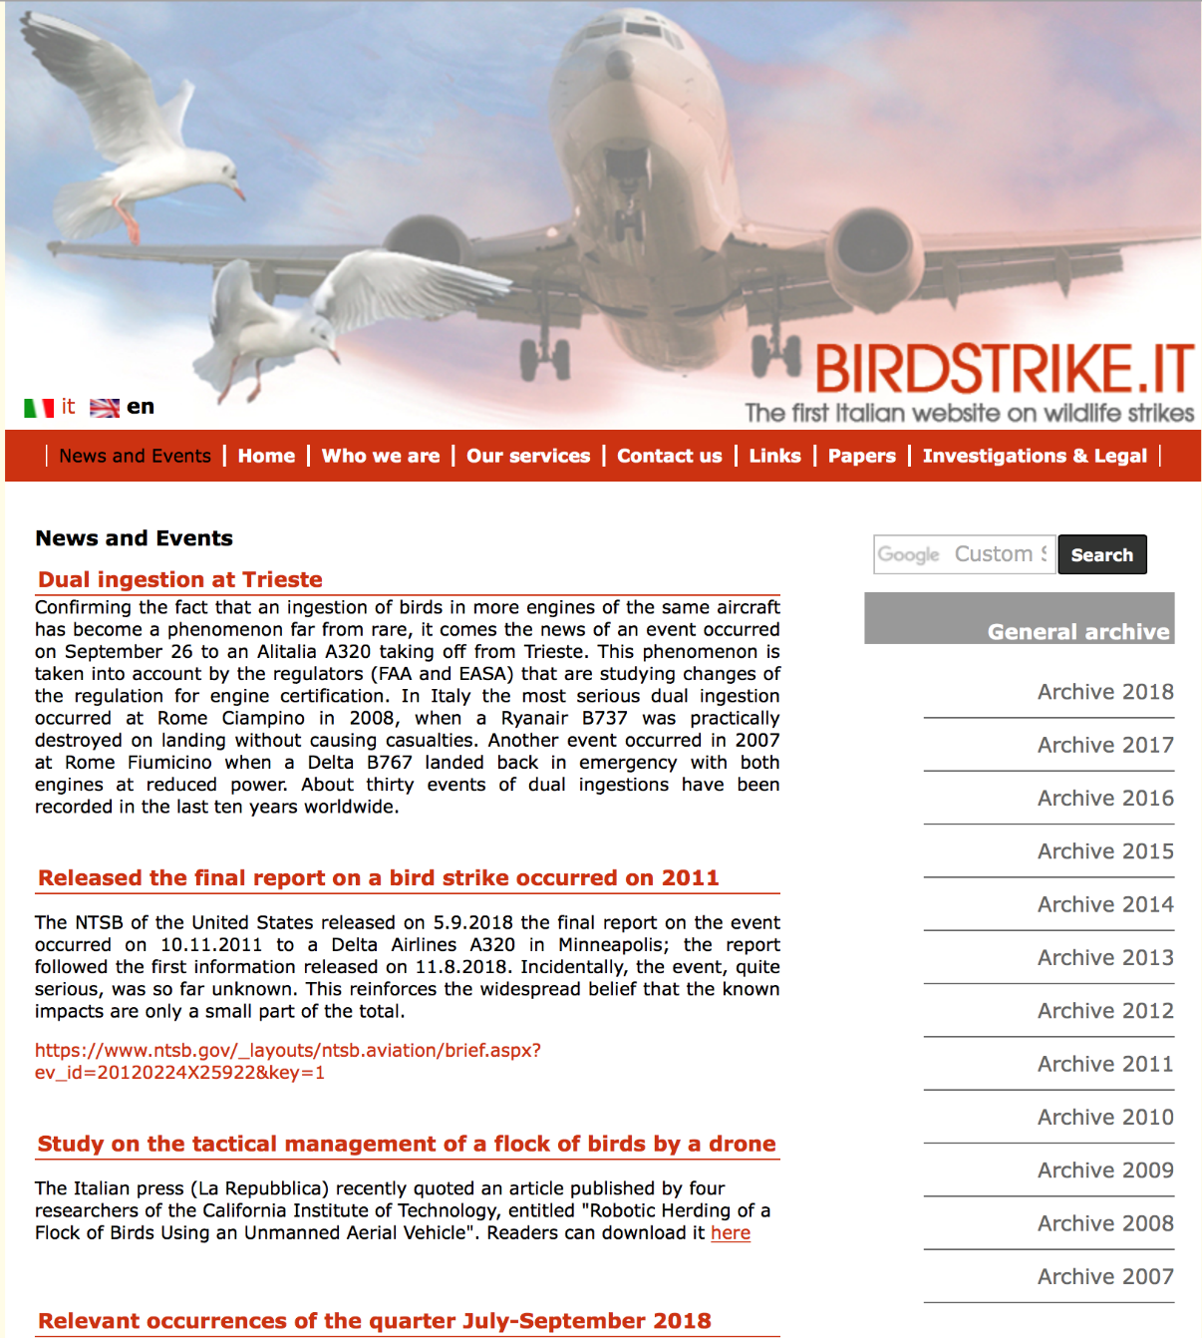
Pyramid Indicators
Adverse Effect on Planned Flight (AEPF):
Damage
Delay
Cancellation
Forced landing
Precautionary landing
Diversion
Non-standard DAP
Aborted TOFF
Missed Approach
Focus investigation and
management in this area
to ultimately reduce FAT/HL
Notes:
BUT what about the pyramid indicators , BOTH Air Safety and Biological, we need to start recording those with the same amount of diligence that we record the fatal accidents
One goal/aim for the short to medium term is to document the pyramid indicators much m ore closely. Manage the pyramid indicators rather than simply count the serious accidents !
WRT Strikes AEPF thanks to Valter’s site we have a start point for recording and analyzing those incidents ~200/year

Slide 18
Pyramid Indicators
Hull
Loss
5
HL/10⁵
Serious Incidents
177
SS/10⁵
Damaging incidents
~8000
DS/10⁵
Non-damaging Incidents with
Adverse Affect on Flight
~10000
NDAE/10⁵
Strike Incidents
(MAC between birds and Aircraft)
~100,000
Strikes/10⁴
Wildlife Fatality
Accidents
Unsafe
Accidents
Animal Welfare
Incidents
Costly
Incidents
Conservation
Incidents
Incidents
AEROECOLOGY
AIR SAFETY
MASS(kg)/10⁴ movements
Notes:
Can see the sample size at top of pyramid is small which makes it difficult to only work with that data
For reference: Global YR 2012
Serious strike incidents based on Valter’s Italian site
Work completed by Shaw and McKee (US Bird strike Conference, August 2016)

Slide 19
Pyramid Indicators
Very High Risk
High Risk
Medium Risk
Low Risk
Notes:
Top 20 busiest US airports (by aircraft movement), top 18 CAN, top 10 AUS
Used publicly available strike data (US & AUS) and reports (CAN)
Movement data from ACI
Mass data from Dolbeer (US), Noel (CAN) and Avisure (AUS)
Year 2014
Work completed by Shaw and McKee (US Bird strike Conference, August 2016)

Slide 20
Pyramid Indicators
MAC
(Strikes)
Mass Struck/10⁴ movements
Near miss Strikes
Wildlife – aircraft Conflict (LOS)
Near Misses/10⁴ movements
Mass (kg) Flux X A/c Movements/hour
Wildlife Airspace Infringements (WAI)
Mass(kg)flux/hour
Flight Planning and Preparation Failure
Procedures, Comms,
Phraseology &Training required
Complacent attitudes
Poor Wildlife Risk Assessment
Training required
Notes:
Work completed by Shaw and McKee (US Bird strike Conference, August 2016)
Should be using Level Two/Three (pink and orange) metrics for management and monitoring.
Monitoring technology such as radar could assist with the mass flux information.
In the interim mass Struck normalised for movements is a reasonable indicator of risk to all sectors.

Slide 21
Fatalities and Destroyed Aircraft - Worldwide
 | No. Hull Losses | No. Fatalities
Civil | 203 | 339
Military | 411 | 212
Total | 614 | 551
NOTES:
1. What about the pyramid indicators?
Damaging Strikes
Strikes with an adverse effect on planned flight?
Strikes with an adverse effect on conservation/animal welfare?
Notes:
Continue to track this important information but use it as an example of how we should approach and investigate incidents to prevent accidents

Slide 22
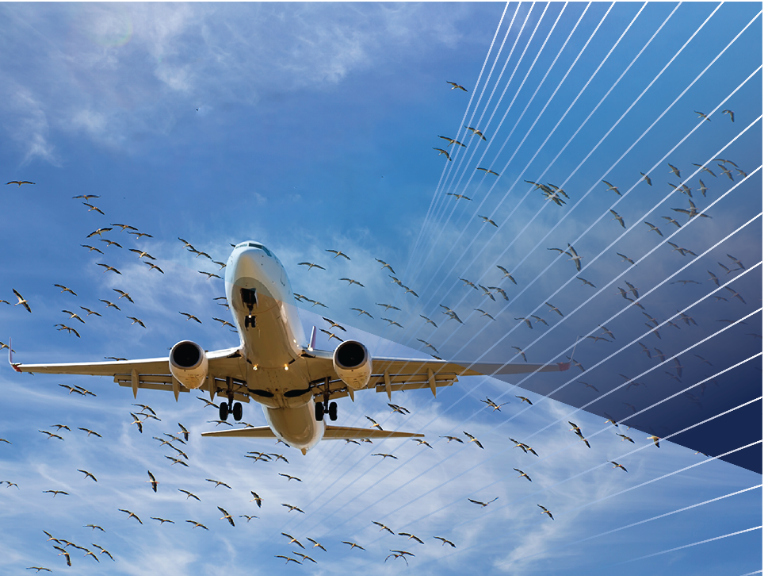
THE BIRDSTRIKE SOLUTION
www.avisure.com

